Slide 1

HOTEL DATA ANALYSIS

Slide 2
Goal
Develop a Database to Analyze & Visualize Hotel Booking Data

Slide 3
Build a visual data story or dashboard using Power BI to present to the stakeholders.
Requirements
“Is our hotel revenue growing by year?”
We have two hotel types so it would be good to segment by hotel type.
“Should we increase our parking lot size?”
We want to understand if there is a trend in quest with personal cars.
“What trends can we see in the data?”
Focus on average daily rate and quests to explore seasonality.

Slide 4
Data Analysis Project Pipeline
1
Build a Database
2
Develop the SQL Query
3
Connect Power BI to the Database
4
Visualize
5
Summarize Findings

Slide 5
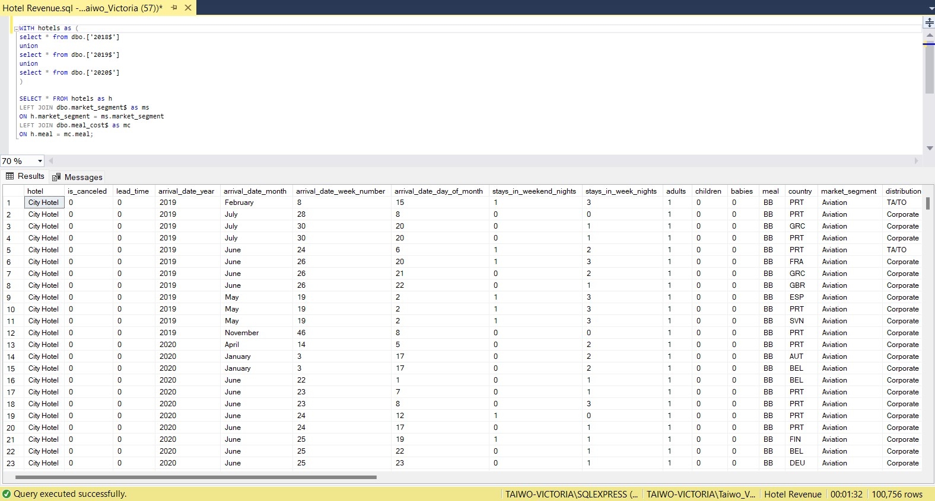
HOTEL BOOKING DATABASE (SQL QUERY)

Slide 6
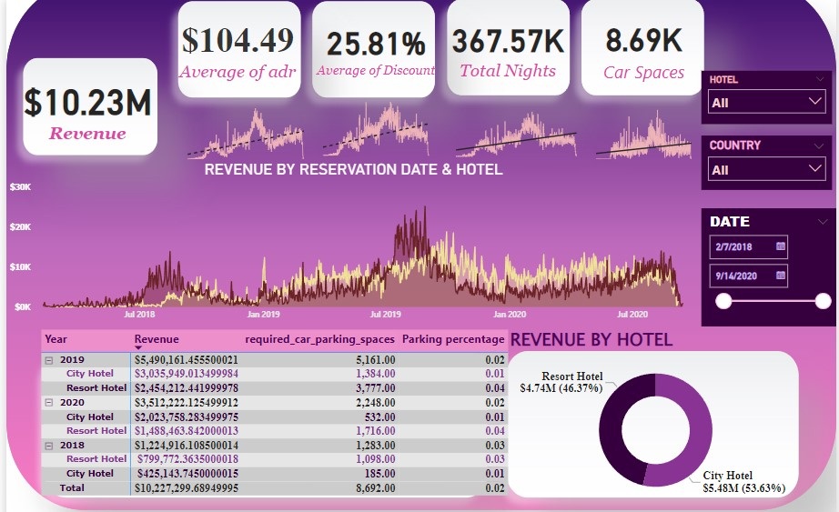
HOTEL BOOKING ANALYSIS DASHBOARD (POWER BI)
CITY HOTEL
RESORT HOTEL

Slide 7
ANALYSIS SUMMARY
From the visualization, it can be deduced that
For the two hotels, the revenue increased towards the end of each year for the three years, and City Hotel revenue is greater than Resort Hotel by 7.26 overall.
There is not enough information about the parking lot so increasing the parking lot size decision can not be deduced.
The small area charts shows the trend for the average daily rate, discount, total night, and the required car spaces in the hotel.

